Slide 1
Mail Management System (fka. Smart Mail Mentor)
Team Members
Sathvik Chowdary Samineni(Lead)
Purushotham Kalangi(Piyush)
Rakesh Kuchipudi
Course
Capstone Project CS-691

Slide 2
Introduction & Motivation
Smart Mail Mentor (SMM): Revolutionizing Email Management with AI-Powered Insights"
Motivation:
Information Evolution (Books -> Search Engines ->LLMs)
LLMs Transformation(Information access -> Process Billions of Words -> Complex Queries
Email : Corporate Critical Communication Tool (Large volume emails -> SMM -> Reports/Insights
Imagine returning/resuming from a 10-day vacation to 100+ emails. How to check emails with enough? bandwidth
Solution: Light Weight Chrome Extension. Generates a report of priority emails with actionable insights that saves valuable time.
Develop a chrome extension an AI-driven tool to process large volume of emails , generate time-based reports, and reasoning capabilities(t.b.i) for better decision making
Problem Statement:
Objective:

Slide 3
Why SMM? A Comparative Analysis
Why SMM stands Out in the Market
Feature | Existing Tools (SaneBox, Superhuman, Cortana) | SMM (Our Tool)
Basic Email Customization | Yes | Advanced
Time-Based Reports/Summaries | No | Yes (Core Feature)
Email Categorization | Limited and Manual sifting through each email | Yes (6 Categories)
Reasoning Capabilities | No | Yes (Future Scope)
Lightweight & Performant | Varies | Yes
Unique Value Proportion:
Email Segmentation
Business/Work
Security/Alert/Trancational
Online Order Alerts
Promotional
Subscription/Renewals
Personal
Our tool extracts Top 5 emails per category and actionable insights, making email management efficient and focused

Slide 4
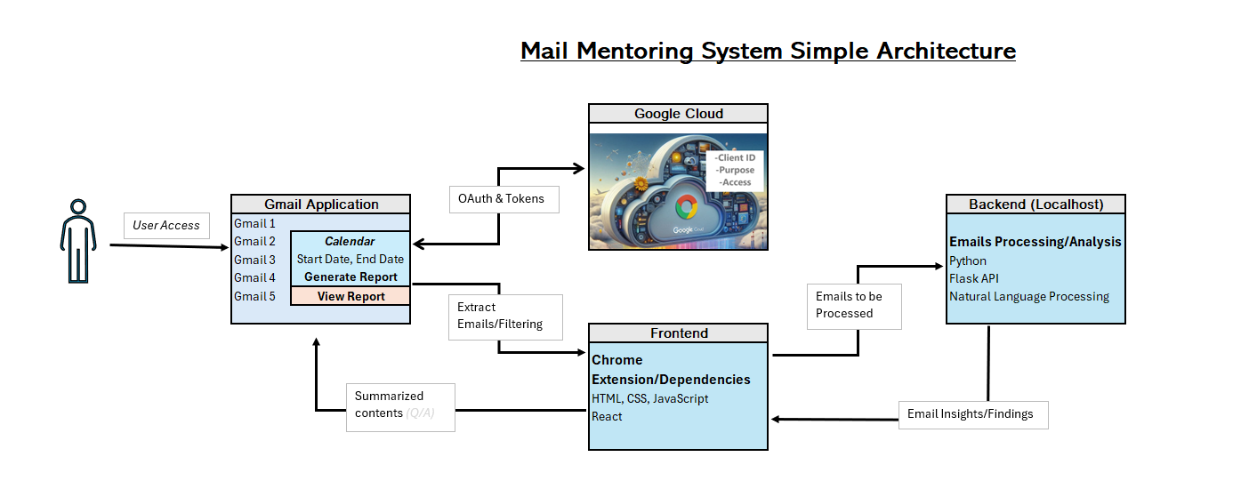
System Architecture
Frontend
Lightweight Chrome extension built with HTML, CSS, and JavaScript.
Backend
Python-based processing engine for email classification, summarization, and report generation.
Dataflow
Emails fetched via Gmail API.
Processed by backend (App.py) and Insights returned to the frontend in JSON format.
Key Files
manifest.json, validation.js, background.js, App.py.

Slide 5
Dataset Introduction & Data Processing Dataset Overview & Preprocessing Pipeline
Dataset Source:
Initial Attempt: Enron Email Dataset (500k+ emails)
Challenges: No sufficient data to meet our project, crash during unzip.
Key Columns: Email_Id, Status.
Another approach:
Using faker library, generated synthetic email data.
Email data not meaningful.
Manual Entry:
Entered email in excel manually.
Challenges:
1. Faker faulty synthetic emails.
2.Manual entry requires lot of time.
3.Enron dataset had insufficient data.

Slide 6
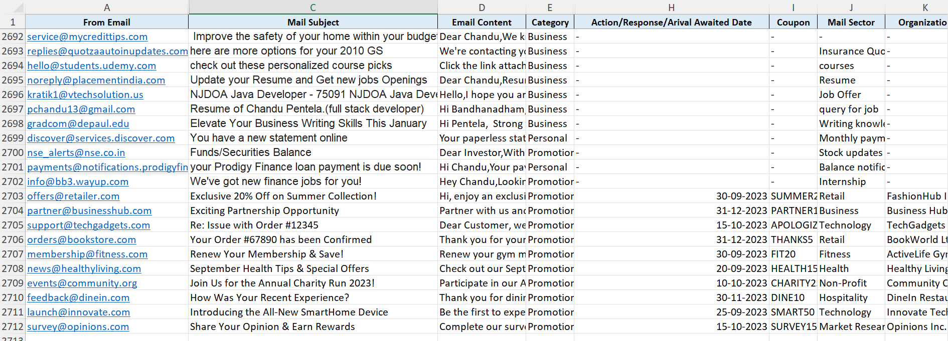
Current Dataset:
Email-parser:
2,500+ real-time emails from personal inboxes.
Data Dictionary:
Key Columns: From, Subject, Mail Body, Next Action Awaited, Category, Promo-Codes, Generic Mail Category
Observations:
Added custom columns (Next Action Awaited, Category) to meet reporting requirements

Slide 7
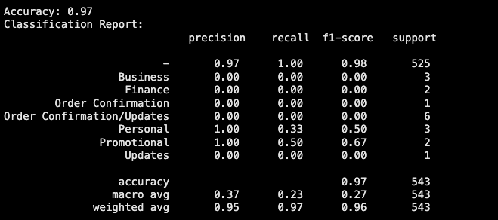
Email Classification
TF-IDF (Term Frequency-Inverse Document Frequency): Used for converting email content into numerical features.
Random Forest Classifier: A machine learning model trained on the TF-IDF transformed text to classify emails into categories.
Challenges:
Class Imbalance: Some categories had very few emails, making it difficult for the model to generalize.
Incorrect Labeling: Emails with the '-' category were not categorized properly and needed better classification.

Slide 8
Methodology / Approach
Frontend(Chrome Extension)
Backend (NLP Pipeline in Python)
Integration Strategy
Built with HTML, JS, and CSS
Uses OAuth2 for secure Gmail API access
Displays emails and control UI using a popup interface
Preprocessing using nltk and spaCy
Classification and Summarization using transformer models with enhanced (BERT, TextRank)
Used heuristic and model-based methods for prioritizing and tagging emails
Processed email data in the notebook for insights and classification
Planned architecture for eventually sending results back to the Chrome extension

Slide 9
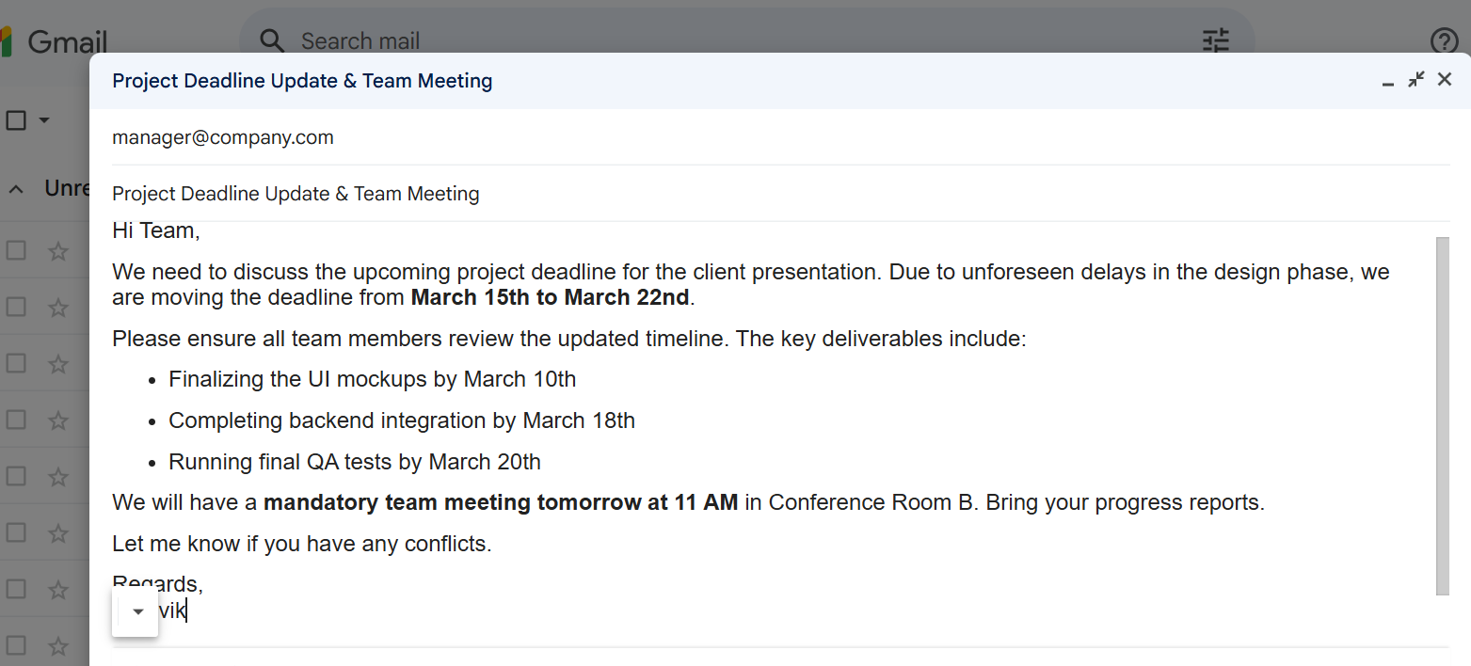
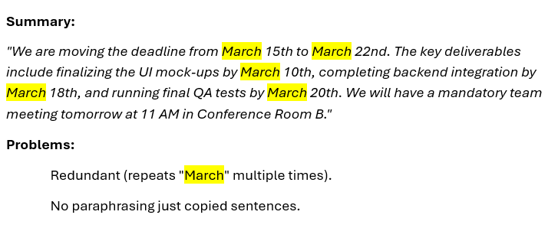
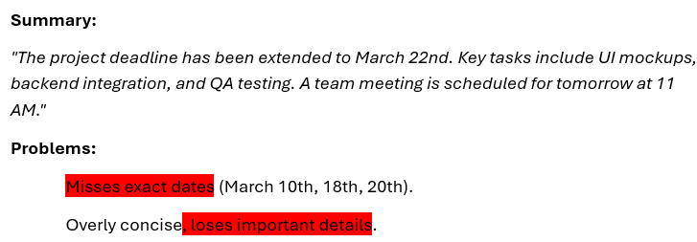
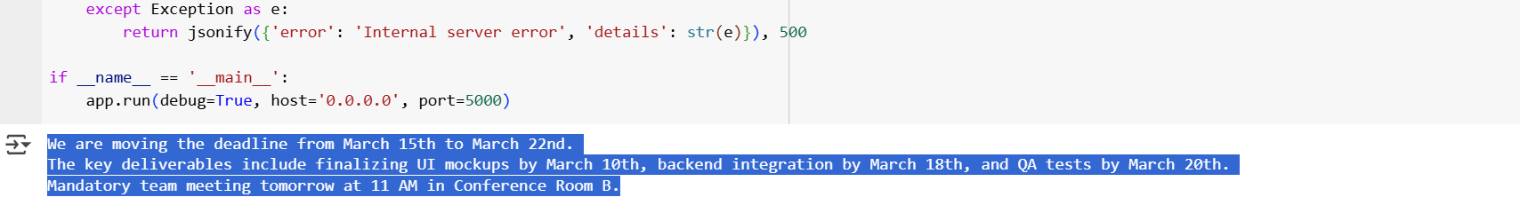
Reformulated/Fine-tuned Idea
Requirement : Accuracy and Coherence
Testcase 1. Problems with existing models?
Extractive – Redundant, Purely Copied & Abstractive – Miss Dates, Overly Concise
Extractive Enhancements – Position Aware sentence weighting, Semantic clustering, Dynamic sentence selection (30%)
Abstractive Enhancements – BART process extractive pre-summary (Reduced hallucinations), Beam searching
Traditional Methods
Text Rank (Extractive) vs Abstractive(BART)
Hybrid Refinement
Text Rank (Extractive) vs Abstractive(BART)

Slide 10
Key Features / Results
Extension Capabilities
ML/NLP Features
Zero-shot classification for tagging (e.g., "Work", "Urgent")
Visualization and Evaluation
Clean and responsive popup UI
Priority scoring based on keyword and model-based importance
Login, fetch, and refresh Gmail emails
Extractive and abstractive summarization.
Plotted classification confidence, summarization length
Evaluated with ROUGE and accuracy metrics

Slide 11
Hurdles/Challenges
Data Access
OAuth & Chrome Limitations
Refresh token management and maintaining user sessions was tricky
Bridging Frontend with NLP Model
Currently offline; integrating extension with model (e.g., via Flask or cloud service) is a future goal
Lack of labeled email datasets meant relying on Gmail API and manual curation

Slide 12
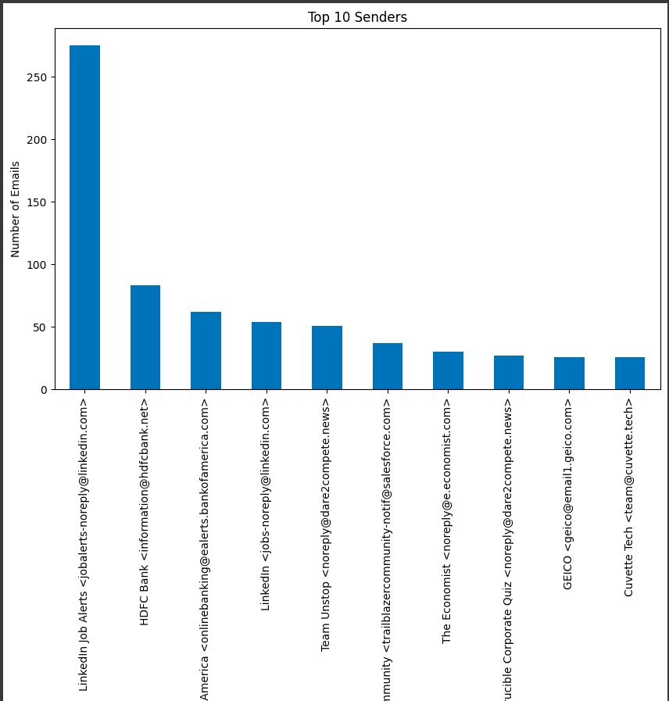
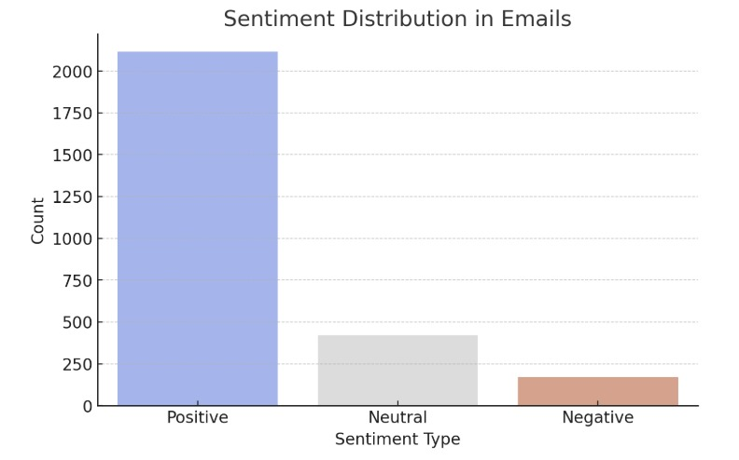
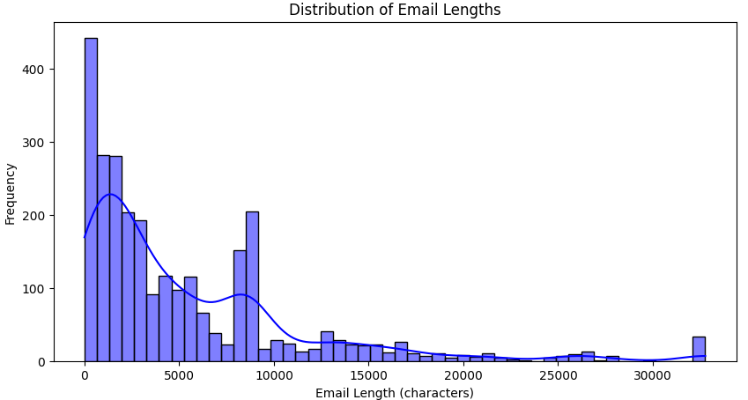
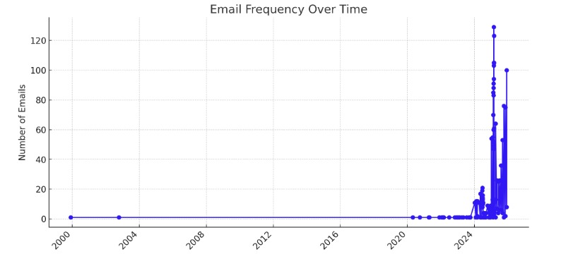
EDA & Data Visualization
Initial Sender Mailbox Analysis
Email Word Count and Length Histogram Analysis
Sentiment Analysis (Determination of Classification)
Email Distribution Analysis
Time based period Analysis

Slide 13
Conclusion
Future Work
Functional Hybrid Summarization Pipeline
Improve Timeframe UI
Overcome Data Limitations
Advance Reasoning Capabilities
Developed AI-Powered Email Management System
Scalability, Integration & Real-world Implementation

Slide 14
Thank You!

Slide 15
Q&A and Feedback

